Slide 1


BUT Informatique S1
CALL of DUTY Warzone
Colas NAUDI TD2/TP4
8th October 2021

Slide 2
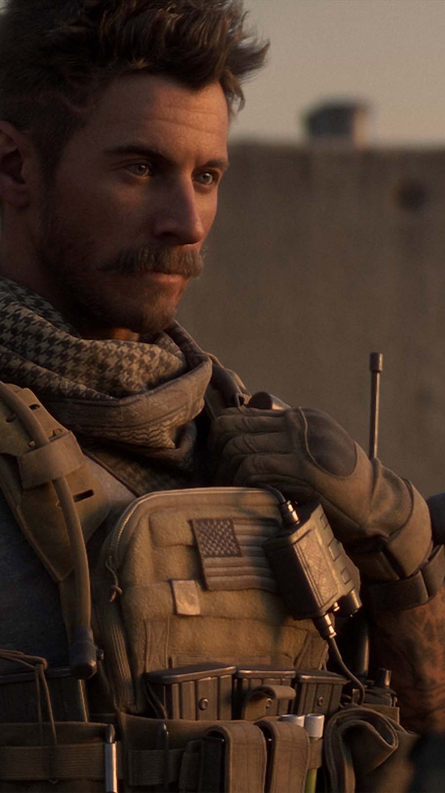
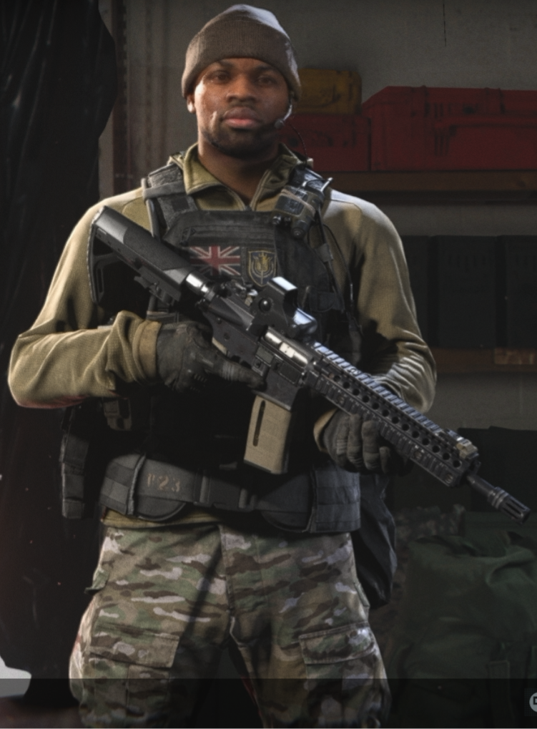
Presentation Highlights
Introduction
Purpose
Description
Characters
How to win ?
Particularities

Slide 3
Introduction
CALL of DUTY: Warzone is a free-to-play battle royale video game released on March 10, 2020, for PS4, Xbox One, Microsoft Windows, PS5 & Xbox Series S/X. This game was developed by Infinity Ward and Raver Software and published by Activision. The game is rated PEGI 18, so you must be more than 18 years old to play this game.

Slide 4
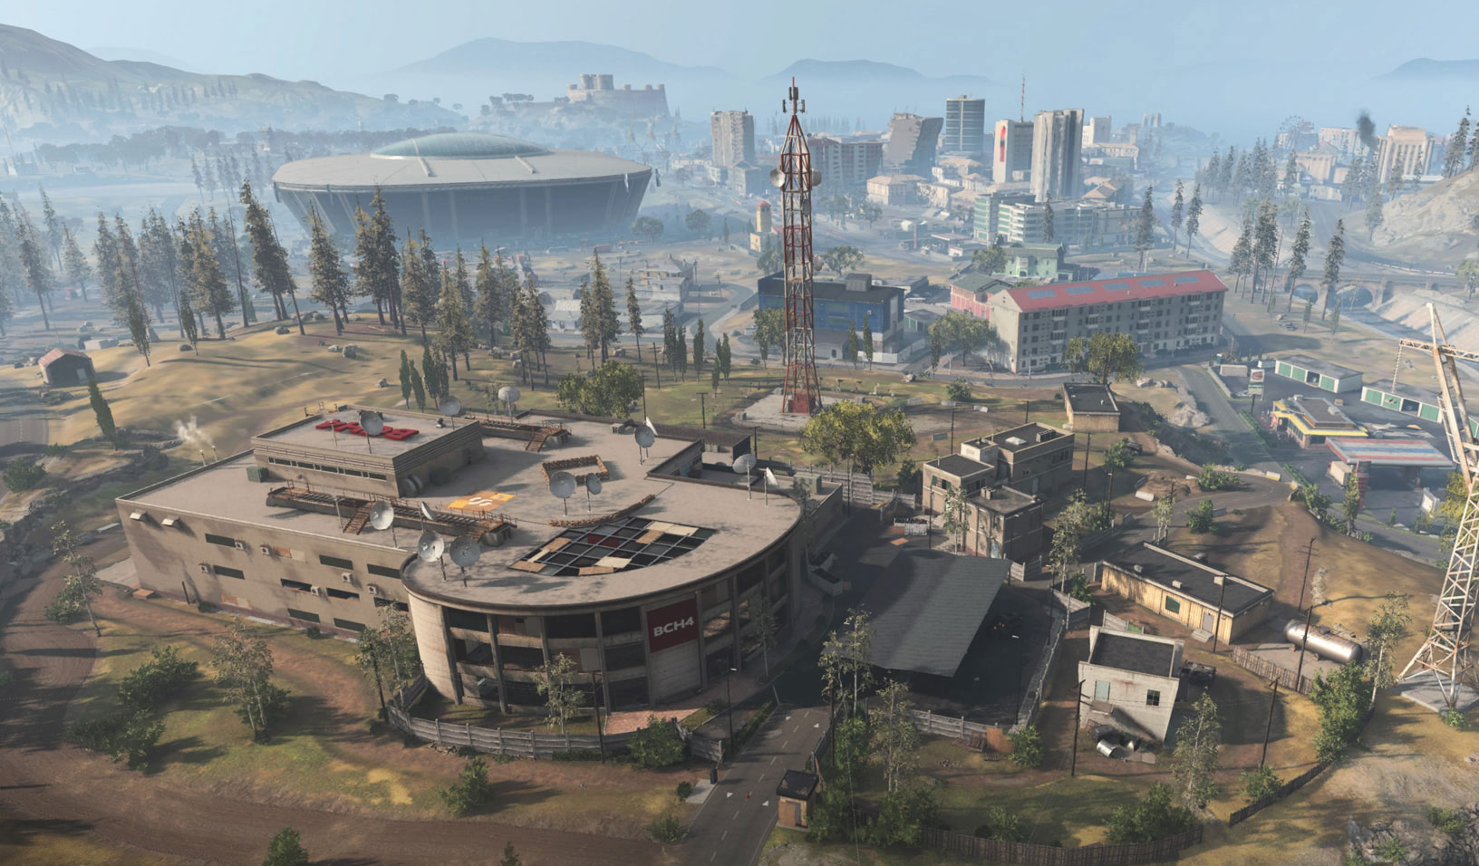
Purpose
The main purpose of the game is to be the last player alive among 150 players.

Slide 5


Description
09
150
1
PLAYERS
WINNER

Slide 6



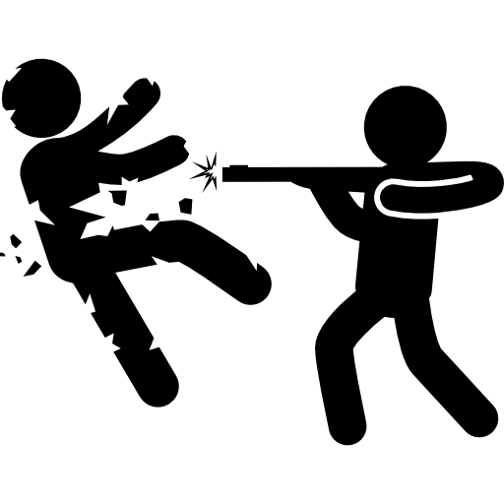

1
2
3

Slide 7
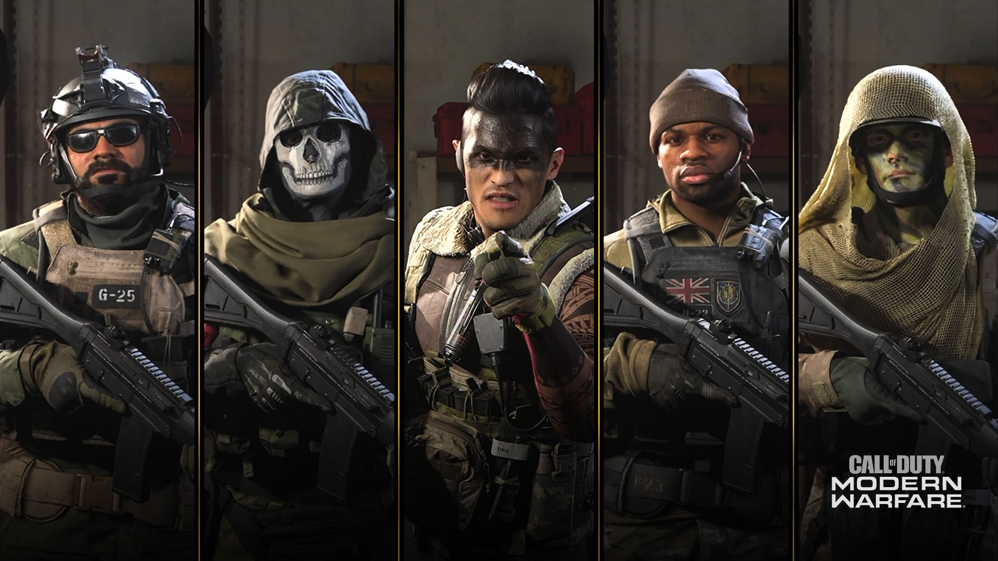
The characters
These are a part of all the characters in the game. You can get more style buying skins for your character, but it doesn’t improve your gameplay. Characters have no impact on the game.

Slide 8
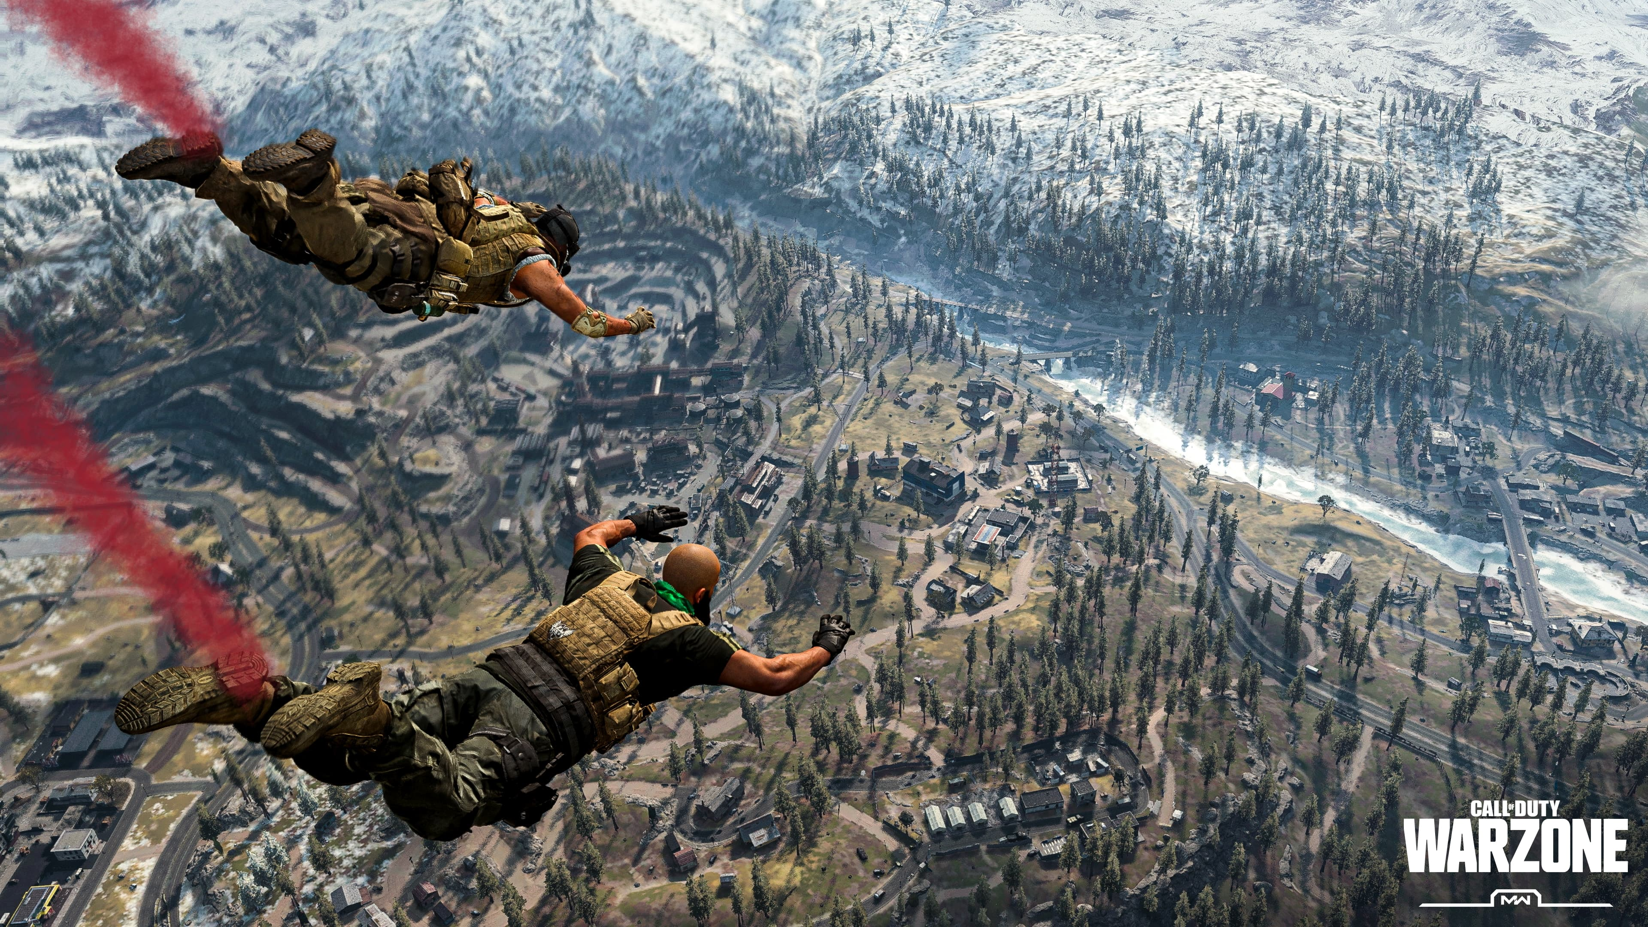
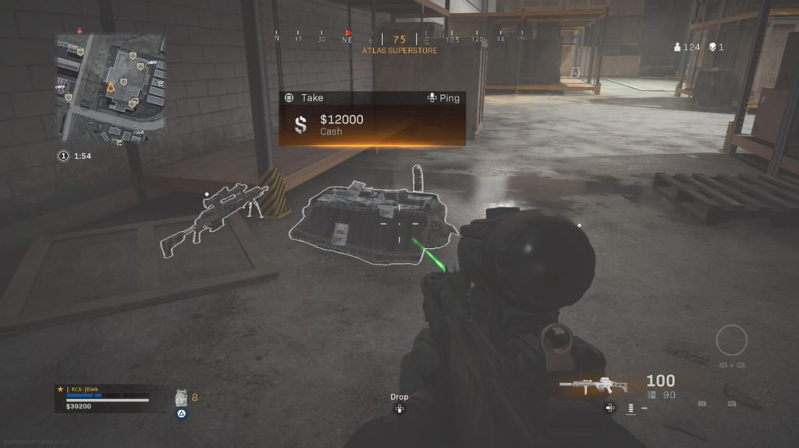
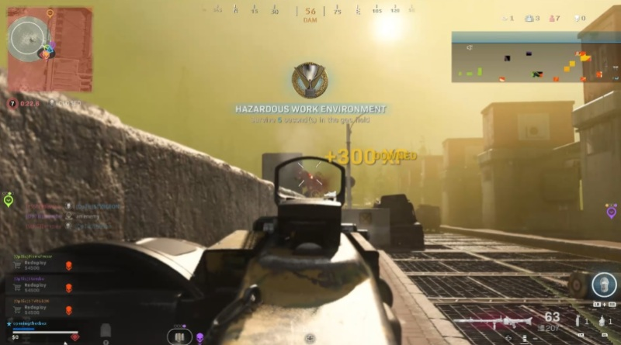
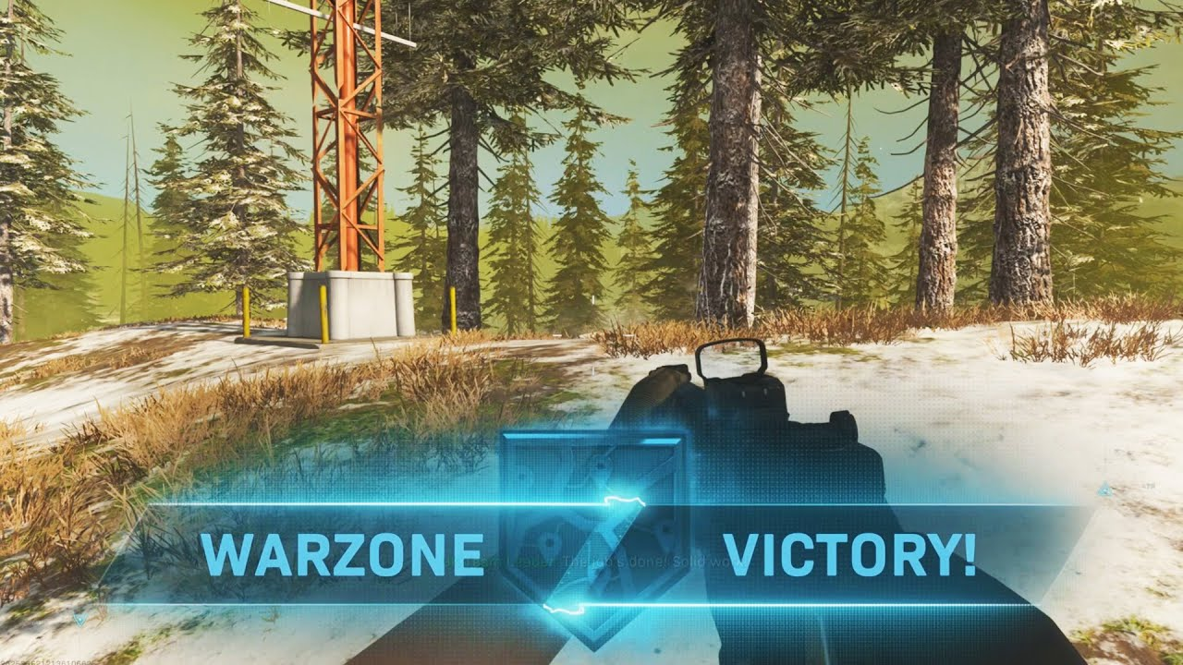
How to win ?
1
Choose a place to drop with a lot of stuff
A good landing is the key to win a game. If you choose to land in a big city, there are a lot of chance for you to get good weapons. But also, to meet more opponents.
2
Get a lot of money to get your weapons
If you find 10.000$ you can get a loadout drop marker. It’s an airplane who drop a crate with all your classes of weapons inside.
3
Kill your opponents
Warzone is a battle royale, you must be the last player alive to win. Players can leave the game just by being killed or falling from a high places (this option is uncommon).
4
TAKE THE WIN !

Slide 9
Particularities
1
Gulag
2
Self-revive
When a player die, he has one last chance to come back in the game. He must pass into the Gulag. It’s a place where all the dead players are, and they wait for their match. Two dead’s players face to face with a gun and just the winner can come back in the game the other come back in the menu
In the shop you can buy for 4500$ an auto-revive. If a player kill you, you don’t go instantly to the Gulag. If you have the time to revive yourself, you can continue to play. If the player shoot at you when you are reviving yourself, you go to the Gulag.

Slide 10
Thanks for listening

